Slide 1
High Performance Computing Project Proposal
Trevor Corbin

Slide 2
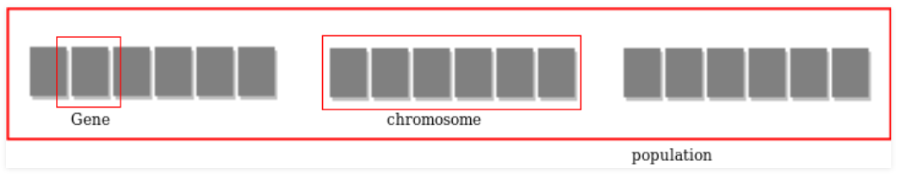
Introduction - Genetic Algorithm
Genetic Algorithm
Simulate natural selection
Each generation consists of a population of individuals
Most “fit” individuals mate and create offspring
Passes along genes
Successive generations are closer to goal

Slide 3
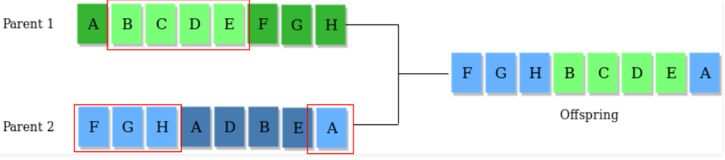
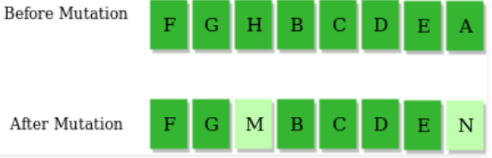
Introduction - Genetic Algorithm
Each generation has a fitness score
Ability to “compete”
Number of characters that don’t match input string
Genes with best fitness scores move on and crossover
Create new gene with better fitness score
Mutate offspring with random genes

Slide 4
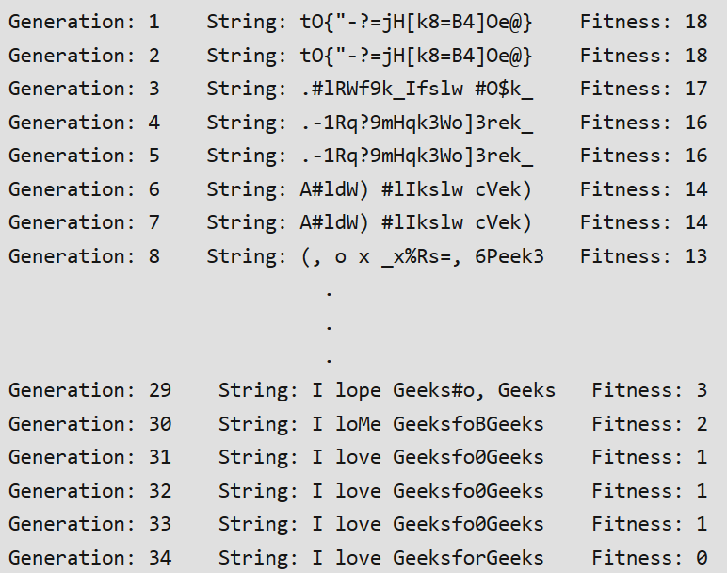
Technology Being Used
Visual Studio
C++
Creating basic UI in Command Line
Input string for program to simulate

Slide 5
Project Goals
Fastest possible arrival at input string
Parallelize as many functions as possible
Selection - Find most “fit”
Crossover - Create offspring from two individuals
Mutate - Maintain diversity by adding random genes to offspring

